Slide 1

The Pandemic’s Effect on Arrests in Baltimore City
Stop! You’re Under Arrest
Presented by:
Gabrielle Bedewi, Leah Muliokela, Tungalagtuya Naran, Emily Rusin
June 2, 2023

Slide 2
Topics
Background
Data Source and Data Prep Steps
Overview of Arrest Charges and Effect of the Pandemic on the Trend
Types of Arrest Charges and Effect of the Pandemic on the Mix
Geographic Concentration of Arrest Charges and Effect of the Pandemic
Limitations and Further Analysis Recommendations
Q & A

Slide 3
Why Baltimore City?
Baltimore, MD has consistently ranked in NeighborhoodScout’s* top 30 most dangerous cities in the U.S., surpassing Washington D.C. every year since 2012 (except for 2022; Baltimore did not appear in the top 100 list).
In 2020 and 2021, Baltimore was the 4th most dangerous city in the U.S.
*Reference: https://www.neighborhoodscout.com/blog/top100dangerous
Based on violent crime rate per 1,000 residents, among cities with 25,000 or more residents. Violent crimes include rape/armed robbery/aggravated assault.

Slide 4
Data Source and Data Prep Steps
url: data.baltimorecity.gov
BPD Arrests at https://data.baltimorecity.gov/search?collection=Dataset
Dataset represents arrests made by the Baltimore Police Department from January 1, 2010 through March 12, 2023.
Data is updated on a weekly basis; last update occurred on 5/23/2023.
Fields included:
-Age
-Gender
-Race
-Arrest Date and Time
-Arrest Location
-District
-Latitude
-Longitude
-Charge Description
362,420 rows and 21 columns
78,750 rows and 21 columns
Selected Arrest dates 1/1/2018 – 12/31/2022
75,506 rows and 21 columns
Excluded Charge Description = “Unknown Charge”
61,603 rows and 21 columns
Grouped Charge Descriptions into Similar Types of Charges
Selected Top 10 Charge Descriptions (based on counts)

Slide 5
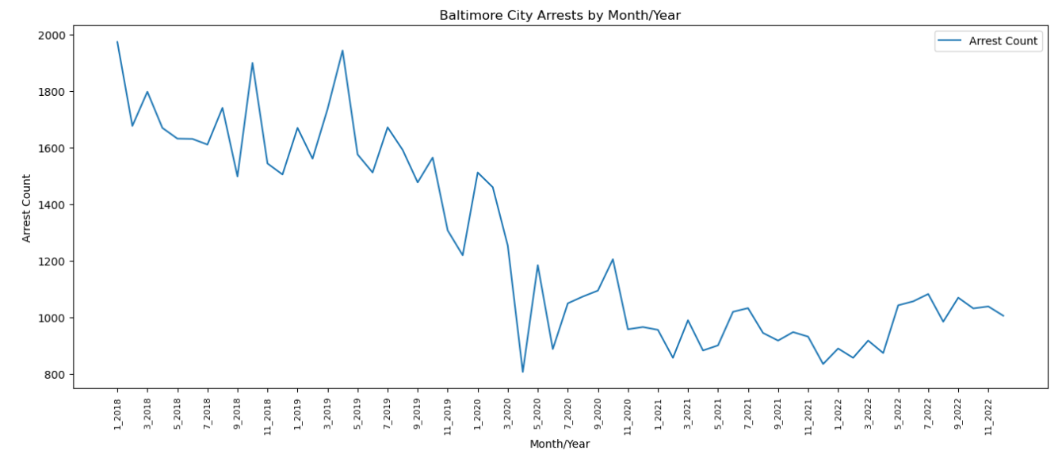
Overview of Arrest Charges and Effect of the Pandemic on the Trend
Number of arrests drops drastically in March 2020, with a visible trend shift prior and after March 2020.
Notes:
The sharp peak after the COVID lockdown was likely due to people turning themselves in to not face jail time due to COVID restrictions with incarcerations

Slide 6
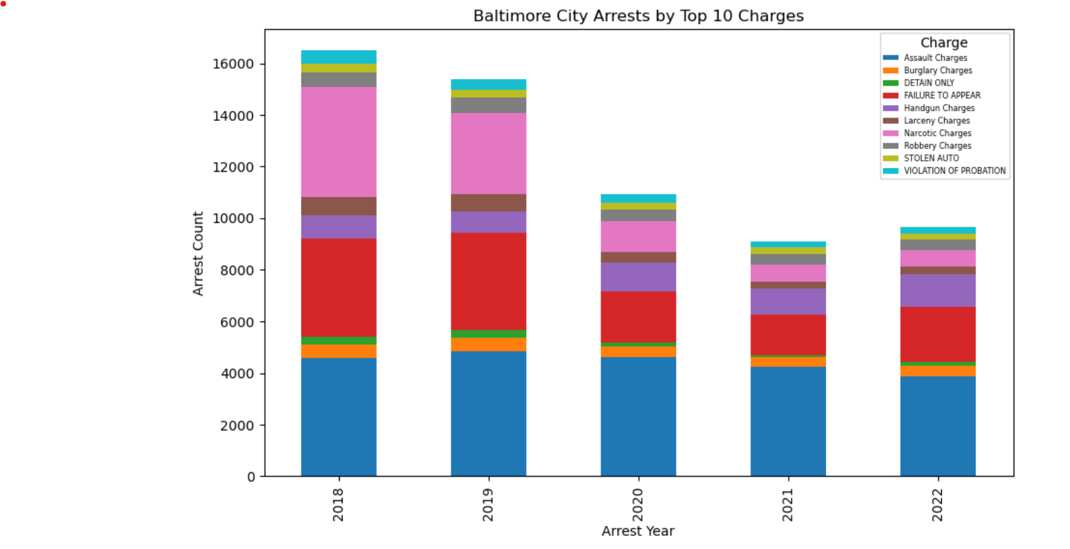
Types of Arrest Charges and Effect of the Pandemic on the Mix
Number of “Assault” charges remained consistent across the 5 years.
Number of “Failure to Appear” and “Larceny” charges decreased starting in 2020.
Largest drop occurred within “Narcotic” charges starting in 2020.
“Handgun” charges increased starting in 2020.
Notes:
~Assault Charges likely didn’t see much of a change as most people were home without the ability to get time away and were dealing with stressors such as financial strain, concerns about the virus, and overall uncertainty. This likely led to domestic disputes and assaults.
~Failure to Appear arrests likely saw a decline as these were often the result of officers being proactive and serving warrants as well as officers conducting traffic stops and encountering citizens in public. Police Departments were stressing the decrease of face-to-face interactions except for emergencies.
~Larceny decreased as stores were closed so shoplifting wasn’t occurring (and again, people were not out and about to have their property stolen).
~Narcotic charges are often proactive. Units conducting undercover operations may have been assigned to other capacities at the height of COVID and the emphasis on drugs likely shifted. Narcotic arrests also stem from traffic stops, which were likely only conducted for serious violations, and other street interactions, which again, were likely halted due to concerns of spreading COVID.
~Unknown why handgun charges increased (handgun charges are going to be concealing a handgun without a permit, possessing a handgun while being a convicted felon, carrying a weapon at prohibited locations (ie. School zones, airports. Etc)), and possessing a handgun while trafficking drugs.

Slide 7
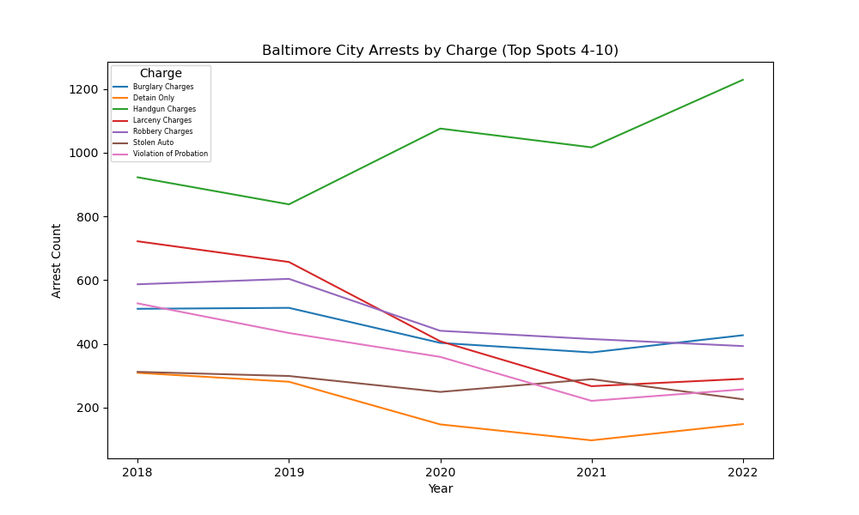
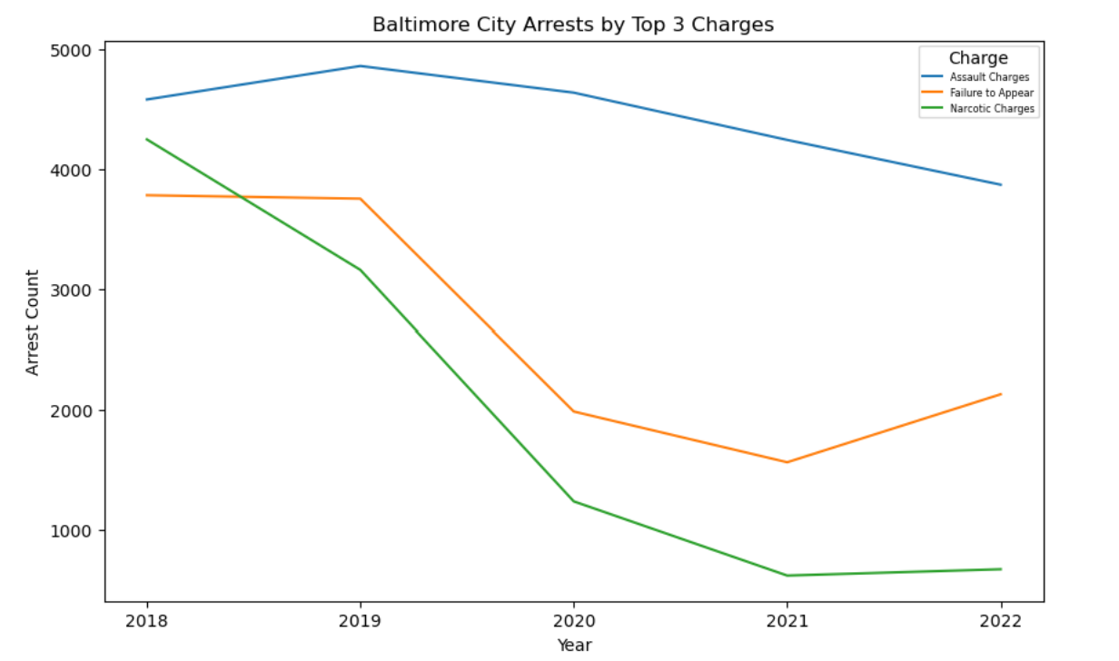
Comparison among the Top 3 vs. Bottom 7 Types of Charges
The top 3 occurring arrests were “Assault”, “Failure to Appear” and “Narcotic” charges.
Arrests for “Narcotic” and “Failure to Appear” charges had the steepest declines in 2020.
All types of arrests decreased in 2020 except for “Handgun” charges which continued to have an increasing trend.

Slide 8
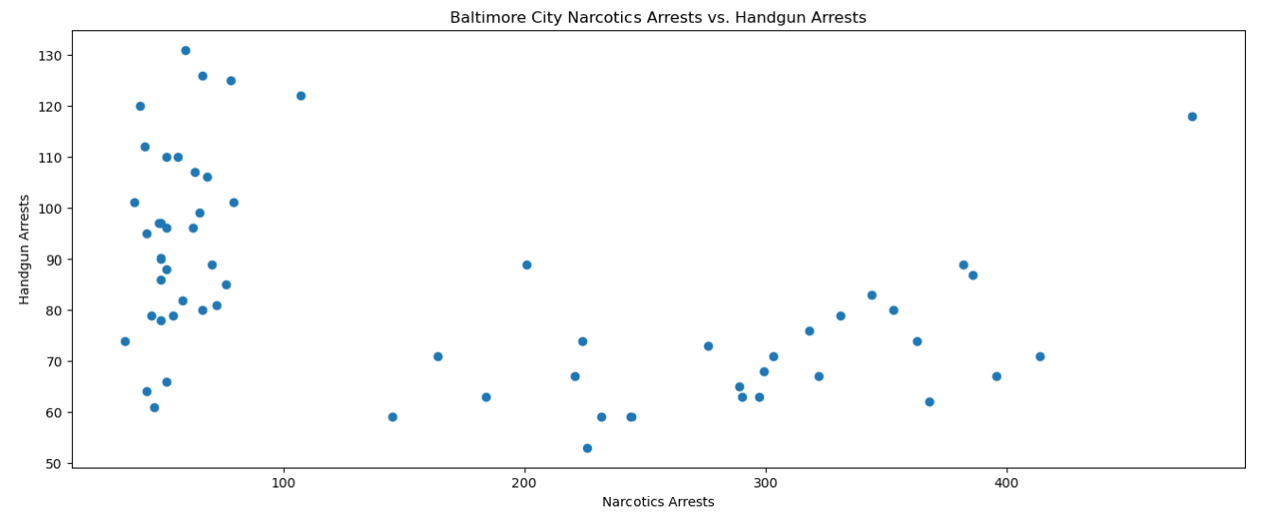
Is there a Relationship between Handguns and Narcotics Arrests?
A negative correlation coefficient r = -0.404 indicates that there is a slight negative linear relationship between “Narcotics” and “Handgun” arrests, when analyzing the overall relationship across the years from 2018-2022.
The scatterplot demonstrates 2 groups of different types of relationships that are worth further analysis.
The correlation coefficient between Narcotics Arrests and Handgun Arrests is -0.4041773384041718
Notes:
We decided to look at the correlation between handgun violations and narcotic violations because when officers are stopping subjects, they are looking for weapons and they are looking for drugs. Also, possessing a handgun while trafficking narcotics results in both handgun and narcotic arrests.

Slide 9
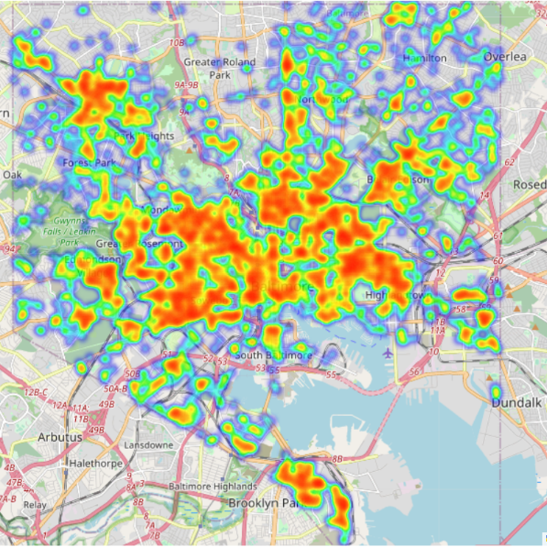
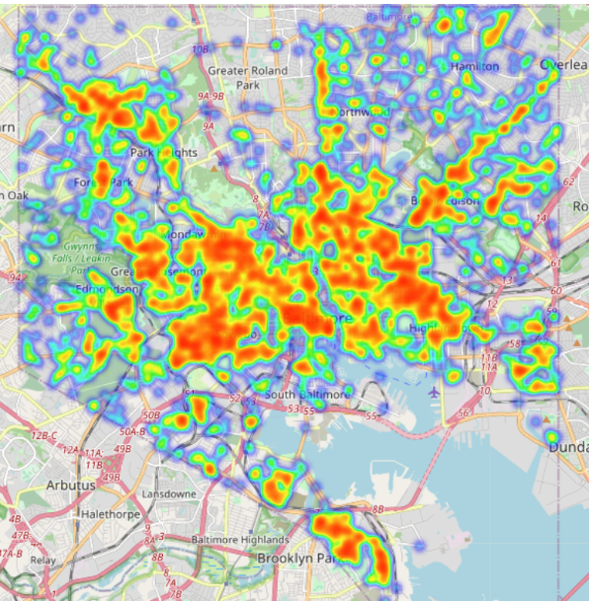
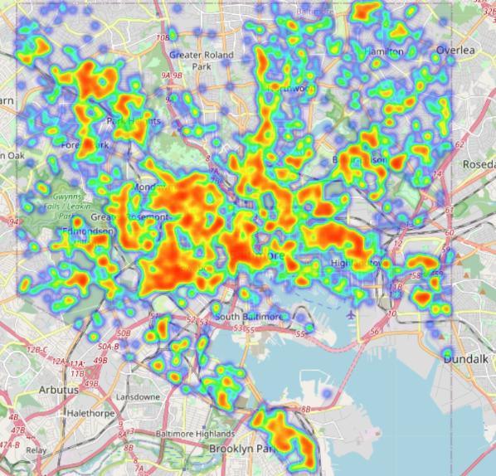
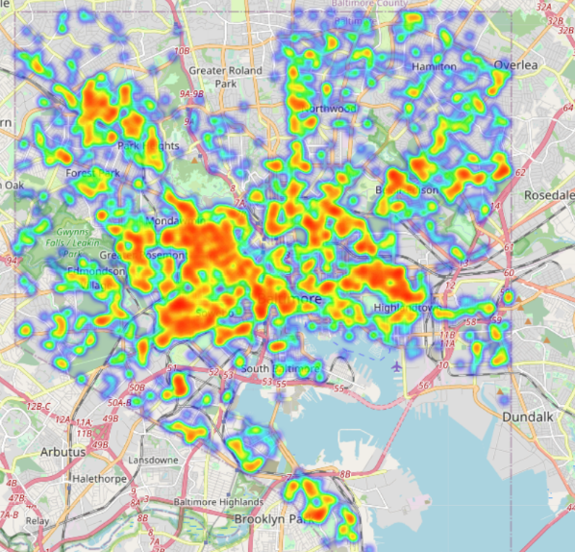
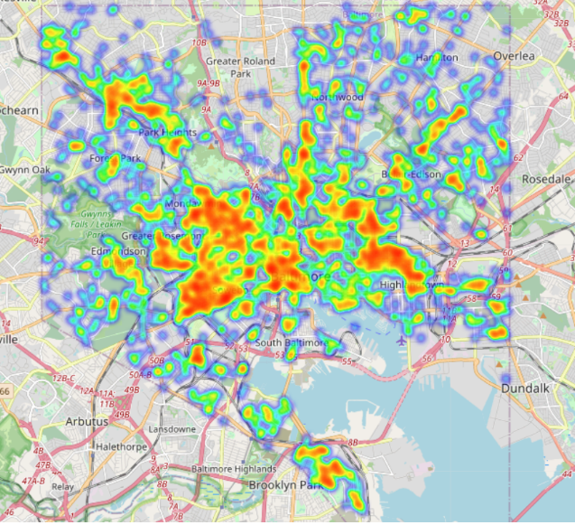
Geographic Concentration of Arrest Charges and Effect of the Pandemic
2018
2019
There is a general reduction in the concentration of arrests starting in 2020, especially at the outskirts of the city.
Largest concentration of arrests is at the center of the city. Others are clustered in the Northwest, Northeast, and Southeast of the city.
2020
2021
2022

Slide 10
Limitations and Further Analysis Recommendations
The dataset BPD Arrests includes the number of arrests for specific types of charges and does not include information about the number and types of crimes committed. Given that there may be a lag time between the time a crime is committed and an arrest, depending on the type of charges, demonstrating a direct effect of the pandemic on arrests vs. crime rate may not be sufficiently apparent or have the same trends.
Evaluate incident data to see if there is a relationship between crimes reported and arrests.
Further investigation into the reasons why arrests for “Handgun” charges increased after 2019, and had a different trend pattern than the other types of arrest, is recommended. For example, were there any special police department initiatives in place for “handgun control”, that may have been initiated by the Mayor of Baltimore or the Governor of Maryland?

Slide 11
Q & A

